Slide 1
Chapter 17, 18, 19
Financial statements

Slide 2
Income statement
Multi-Step

Slide 3
Sales | $16,000
Less cost of goods sold | 9,600
Gross margin | $6,400
Less selling & administrative expense | 5,800
Operating income | $600
Dividend revenue | 62
Interest revenue | 64
Gain/Loss on sale of equipment | 60
Interest expense | (422)
Income from continuing operations before taxes | $364
Provision for income taxes (25%) | 91
Income from continuing operations | $273
Gain/Loss on discontinued operations (net) | 100
Net income | $373
17-3

Slide 4
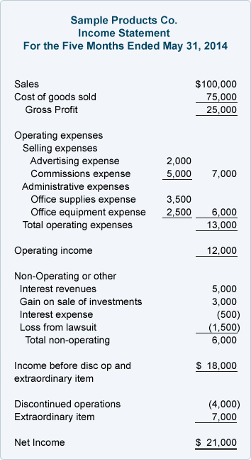
GAAP no longer require Extraordinary Items to be listed separately. (2014)

Slide 5
What are discontinued operations?
The result of a company selling or disposing of a component of an entity
Ex: phasing out of product line, selling a subsidiary (if Nike would sell the Umbro subsidiary)

Slide 6
Earnings per share
Measures the earnings performance of a company. Levels the playing field by reporting on a per share basis so we can still compare companies no matter the size of the company.
Net income – Preferred stock dividends
(We want to isolate only the earnings that are available to common stockholders)
Weighted Average # of shares of common stock
Don’t forget to include this number
at the end of the income statement!

Slide 7
What is comprehensive income?
Shows all activities that caused changes in retained earnings even the nonrecurring accounting transactions such as
  Unrealized gains and losses from certain investments
  Foreign currency translation adjustments
  Minimum pension liability adjustments
  Derivative-related adjustments
Can be presented as its own statement, attached to the income statement or attached to statements of owners’ equity.

Slide 8
Balance Sheet
Summarizes the relationship between a company’s assets and the claims that creditors/suppliers and owners have on those assets at a given point in time.

Slide 9
Assets
Listed in order of liquidity, which is how quickly the company can covert them to cash or consume them in operations.
Assets must be classified according to their purpose and/or useful life
Five classifications:
  Current assets (CA)
  Investments (LTA)
  Property, plant, and equipment (PPE) (LTA)
  Intangible assets (LTA)
  Other assets (LTA)
The classification between current and noncurrent affect how creditors and investors perceive the liquidity and solvency of a business
  Solvency is the ability to meet obligations when they are due
  For example, reporting more assets as current and classifying more liabilities as long-term would improve liquidity and solvency.

Slide 10
Liabilities
Three Classifications:
  Current Liabilities - due within the next year
  Long-term debt - obligations to creditors due to borrowing
  Other Long-Term Liabilities – obligations not resulting from borrowing such capital leases, pension obligations and deferred taxes
Contingent Liabilities must be disclosed in the notes to the financial statements when the event is probable.
  For example, lawsuit claims related to defective products

Slide 11
Shareholders’ Equity
Represents the claims that owners have on a company’s assets
Section Classifications
  Contributed Capital (Paid in Capital)
    Preferred stock
    Common stock
    Additional Paid-In Capital (Preferred and Common)
  Retained Earnings
    (the ending balance shown on the Statement of Owners’ Equity)
  Accumulated Comprehensive Income
  Treasury Stock
    remember, this is a reduction in shareholders’ equity—these shares are not outstanding and cannot earn dividends
    These shares may be reissued

Slide 12

Statement of Cash Flows

Slide 13
Profit ≠ CasH
Companies go bankrupt not because they are not profitable, but because they can’t pay their bills.
Cash flow is essential to the survival of a business

Slide 14
Statement of Cash Flows
Three sections
  Operating Activities (tied to income statement)
  Investing Activities (buying and selling long term assets and investments)
  Financing Activities (borrowing/paying loans and raising/distributing funds with owners)

Slide 15
Statement of Cash Flows
What is it’s purpose?
  Assess the company’s ability to generate positive future net cash flows. Cash supports future operations.
  Assess ability to meet obligations and pay dividends.
  Assess the reasons for difference between income and cash.
  Asses investing and financing transactions. Even non-cash activities related to investing and financing are either on the statement of cash flows or in the notes to the financial statements.

Slide 16






Cash Flow
Identifying operating, investing, and financing activities
Assets = Liabilities + OE
+
+
=
+
+
Other Current
Assets
A/R
Inventory
Supplies
Long Term
Assets
PPE
Trading securities
Current
Liabilities
A/P
Salaries Payable
Long Term
Liabilities
Notes Payable
Owner’s
Equity
Stocks
Dividends

Slide 17
As cash flows in or out, what is the movement of the other classifications?
=
-
+
-
+

Slide 18
Financing Activities
Operating Activities
Investing Activities
=
-
+
-
+
Current
Liabilities
A/P
Salaries Payable
Other Current
Assets
A/R
Inventory
Supplies
Long Term
Liabilities
Notes Payable
Long Term
Assets
PPE
Trading securities
Owner’s
Equity
Stocks
Dividends

