Slide 1
Recording and evaluating operating activities
Modules 3 & 4

Slide 2
Chapter 7–8
Accounting information systems and
expenditure activities

Slide 3
Chapter 7 Overview
First introduction to debits/credits
Familiar territory for students who have taken Accounting I
Introduction/review the accounting cycle
Adjust time on this module as needed
Starburst/Candy Project (in Module 3 folder)
Practice Set (in Module 3 folder)

Slide 4
Chapter 8 Overview
Builds on Chapter 7 — accounting events
Students should have a solid understanding of the double-entry system
Focus is on expenditures:
  Inventory purchases, returns, discounts
    Periodic and perpetual methods
    Net and gross amounts
  Cash flows (figured using financial statement info)
  Payroll taxes (review from Accounting I)

Slide 5
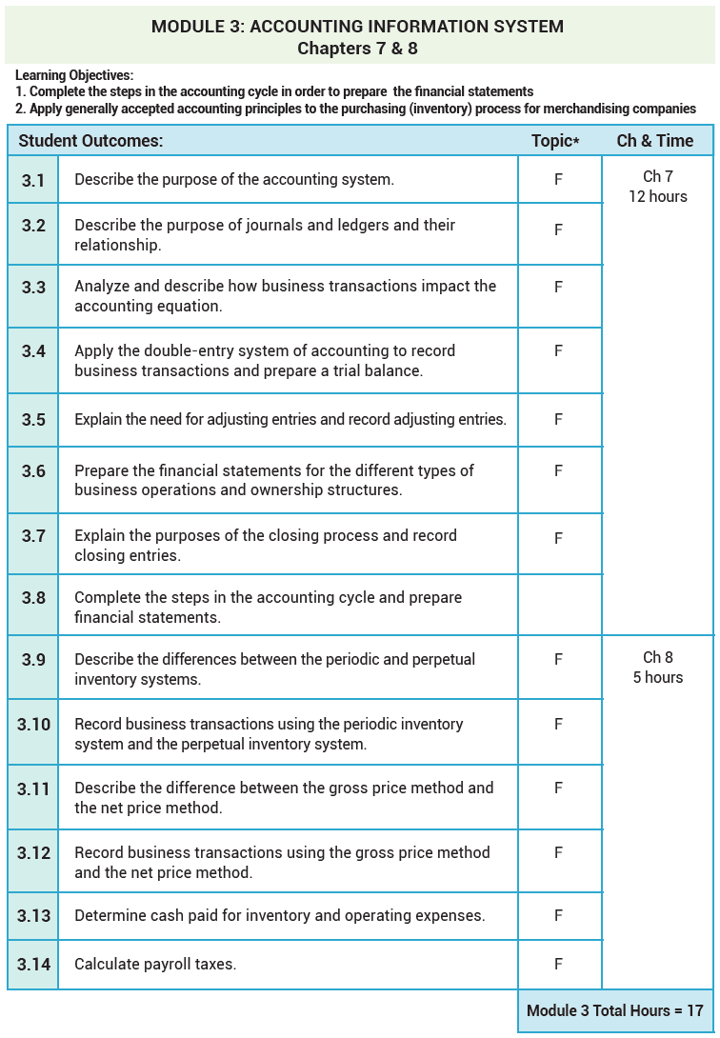

Slide 6
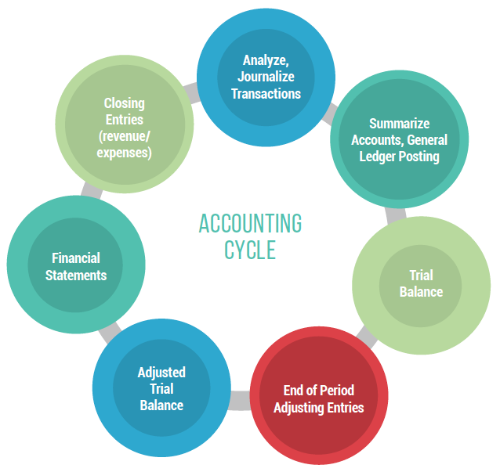
Accounting Cycle

Slide 7
Additional Problem P7.1
From www.mhhe.com/ainsworth7e - Chapter 7 Additional Problems
P7.1 Kendall Corporation began operations on March 1, 2016 and completed the
following transactions during its first month of operations.
    Issued common stock for $100,000.
    Paid $18,000 for a one-year lease on office space.
    Purchased office equipment costing $35,000 by paying $5,000 cash and signing a five-year note for the balance.
    Purchased office supplies on account, $750.
    Sent a bill for $4,500 to a customer for services performed.
    Received $1,000 from a customer for services to be performed next month.
    Paid employees for hours worked, $1,025.
    Paid half of the amount owed for office supplies in transaction (D), $375.
    Received, but did not pay, the monthly telephone bill, $275.
    Paid a dividend to owners, $2,000.
    Required:
    Determine the effect of each of the preceding events on the accounting equation.
    Prepare the general journal entries to record each of these events. Use T-accounts (see next page) to keep track of balances. Do not prepare the adjusting entries.
    Prepare the income statement for the period.
    Prepare the statement of cash flows for the period.
    Prepare the statement of retained earnings for the period.
    Prepare the balance sheet at the end of the period.
    Prepare the closing entries—use T-accounts.

Slide 8
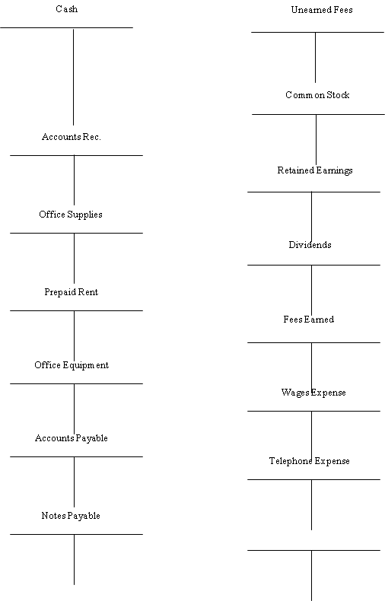
A. 100,000
B. 18,000
F. 1,000
F. 1,000
C. 5,000
G. 1,025
J. 2,000
H. 375
A. 100,000
E. 4,500
Clo. 1,300
Clo. 4,500
Clo. 1,200
D. 750
J. 2,000
Clo. 1,200
B. 18,000
Clo. 4,500
E. 4,500
C. 35,000
G. 1,025
Clo. 1,025
H. 375
D. 750
I. 275
I. 275
Clo. 275
C. 30,000

Slide 9
KENDALL Corporation
Income Statement
For the month ended March 31, 2016
        Revenue
        Fees earned $4,500
        Expenses
        Telephone expense $275
        Wages expense $1,025
        Total expenses $1,300
        Net Income $3,200

Slide 10
KENDALL Corporation
Statement of Cash Flows
For the month ended March 31, 2016
      Cash flows operating activities
      Cash received from customers $1,000
        Cash paid for rent (18,000)
        Cash paid to suppliers (375)
        Cash paid to employees (1,025)
        Net cash flows (18,400)
      Cash flows from investing activities
        Cash paid for office equipment (5,000)
        Net cash flows (5,000)
      Cash flows from financing activities
        Cash received from issuing stock 100,000
        Cash paid for dividends 2,000
        Net cash flows 98,000
      Increase (decrease) in cash flows 74,600
      Cash, March 1, 2003 0
      Cash, March 31, 2003 74,600

Slide 11
KENDALL Corporation
Statement of Retained Earnings
For the month ended March 31, 2016
      Beginning balance $0
      Add net income $3,200
      Less dividends (2,000)
      Ending balance 1,200

Slide 12
KENDALL Corporation
Balance Sheet
March 31, 2016
      Assets
      Cash $74,600
      Account receivable 4,500
      Prepaid rent 18,000
      Office supplies 750
      Office equipment 35,000
      Total assets $132,850
      Liabilities
      Accounts payable 650
      Unearned fees 1,000
      Notes payable 30,000
      Total liabilities $31,650
      Owners’ equity
      Common stock 100,000
      Retained earnings 1,200
      Total owners’ equity $101,200
      Total liabilities and owners’ equity $132,850

Slide 13
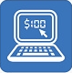
Inventory & IT
http://www.disclose.tv/action/viewvideo/57311/IBM_RFID_Commercial/

Slide 14
Periodic vs. Perpetual Inventory Systems
PERIODIC
Students may be familiar with this system from Accounting 1.
Typically used for less expensive items.
More accounts allow for more info kept on purchases, returns, discounts.
Somewhat of a dead duck due to the information computer systems can track.
PERPETUAL
Everything is in & out the inventory account.
Typically used for more expensive items.
More prevalent today because computer systems make it easy to keep perpetual records.
I
N
V
E
N
T
O
R
Y
Accounts Used:
Purchases
Purchases Returns and Allow
Purchases Discounts
Discounts Lost (net method)
Accounts Used:
Inventory (Asset)
Discounts Lost (net method)

Slide 15
4 Combos Example
Perpetual, Gross
Periodic, Gross
Perpetual, Net
Periodic, Net
A | Inventory | 1000 | Purchases | 1000 | Inventory | 980 | Purchases | 980
 | A/P | 1000 | A/P | 1000 | A/P | 980 | A/P | 980
B | A/P | 200 | A/P | 200 | A/P | 196 | A/P | 196
 | Inventory | 200 | Purchase R&A | 200 | Inventory | 196 | Purchase R&A | 196
C | A/P | 800 | A/P | 800 | A/P | 784 | A/P | 784
 | Cash | 784 | Cash | 784 | Cash | 784 | Cash | 784
 | Inventory | 16 | Purchase Disc | 16
D | A/P | 800 | A/P | 800 | A/P | 784 | A/P | 784
 | Cash | 800 | Cash | 800 | Disc Lost | 16 | Disc Lost | 16
 |  |  |  |  | Cash | 800 | Cash | 800

Slide 16
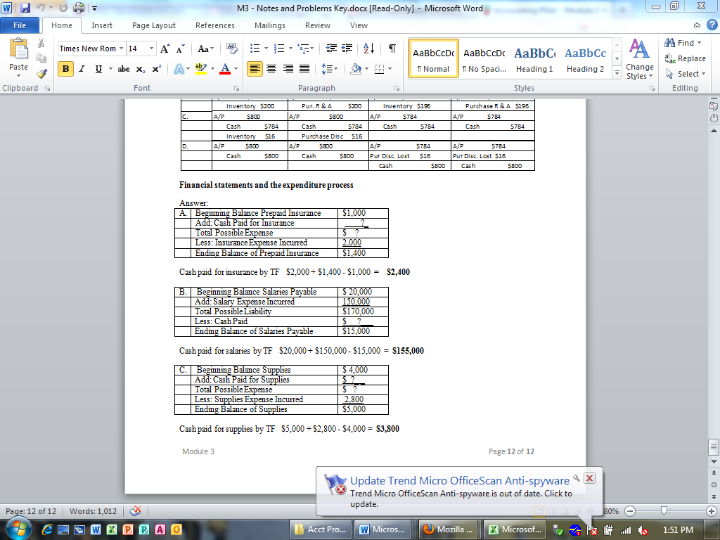
Prepaid Insurance
Start w/:
1,000
Add to it
?
2,400
2,000
Take away
End w/:
1,400
Salaries Payable
20,000
Start w/
Take away
?
155,000
150,000
Add to it
15,000
End w/
Supplies
Start w/:
4,000
Add to it
?
3,800
2,800
Take away
End w/:
5,000

