Slide 1


Janie Patterson
Hutchinson High School
Hutchinson, Kansas
pattersonj@usd308.com

Slide 2
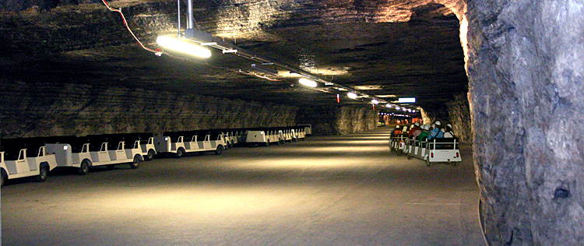
Hutchinson Salt Mine

Slide 3

Kansas Cosmosphere and Space Museum

Slide 4

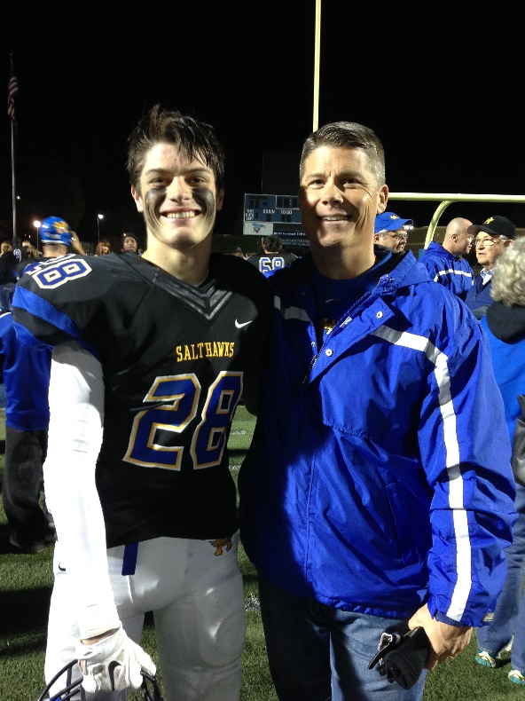
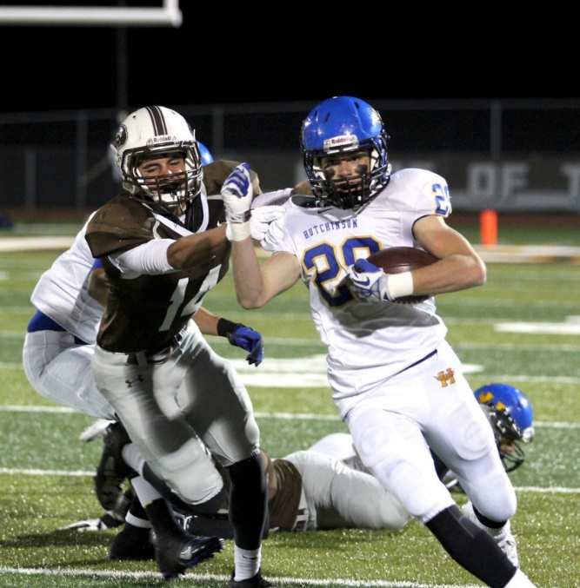


Slide 5
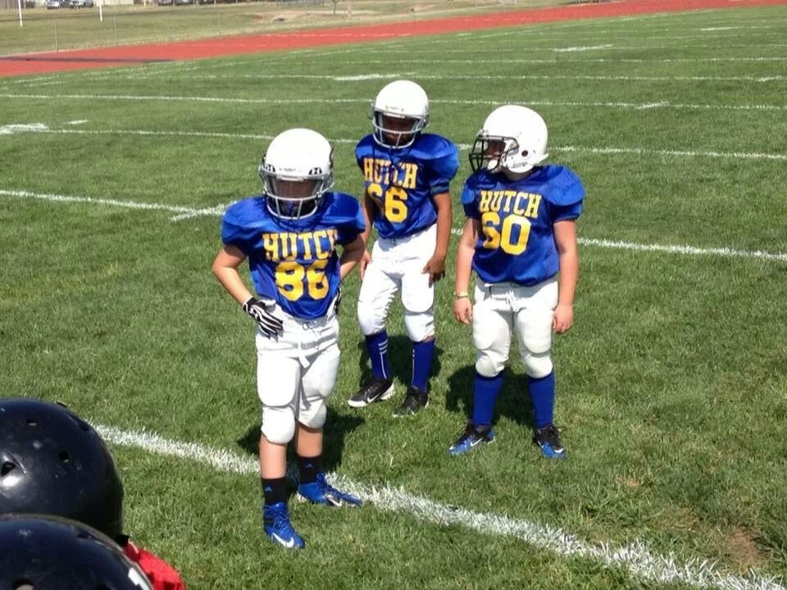
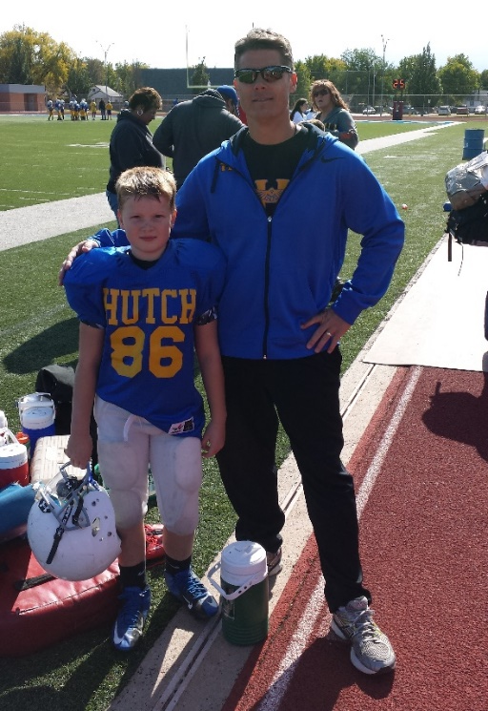
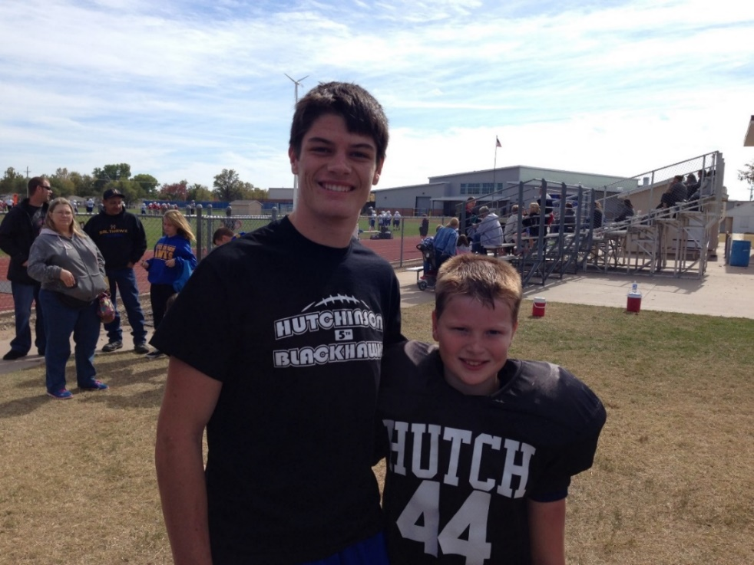
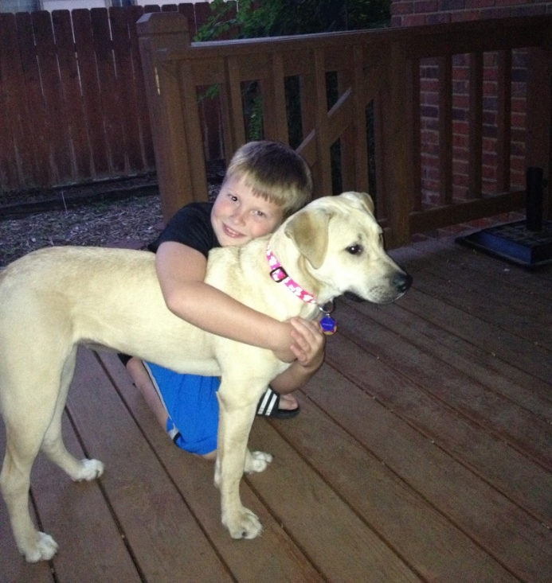

Slide 6
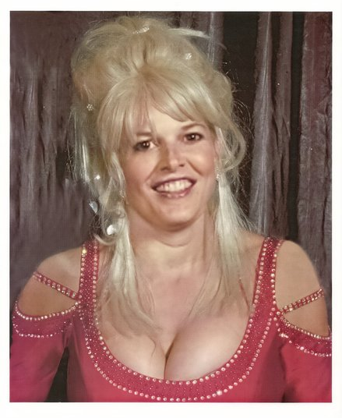

Slide 7
Rigor and Challenge
An easy route from point A to point B is like driving on autopilot. Taking a new road, and maybe getting a little lost along the way, will help you remember the trip.

Slide 8
Benefits of Teaching this Course
Better understanding of the accounting profession
Holistic understanding of business decisions – see the perspectives of all the stakeholders
Making the course your own encourages the use of different types of resources:
  online video clips (Investopedia, YouTube)
  KHAN Academy
  Enron video (“The Smartest Guys in the Room”)
  Shark Tank
  The Profit (CNBC)
  PBS “Is Walmart Good for America”
  CashFlow Game (Rich Dad, Poor Dad author)
  GoVenture

Slide 9
Recording and evaluating operating activities
Modules 3 & 4

Slide 10
Chapter 7–8
Accounting information systems and
expenditure activities

Slide 11
Chapter 7 Overview
First introduction to debits/credits
Familiar territory for students who have taken Accounting I
Introduction/review the accounting cycle
Adjust time on this module as needed
Starburst/Candy Project (in Module 3 folder)
Practice Set (in Module 3 folder)

Slide 12
Chapter 8 Overview
Builds on Chapter 7 — accounting events
Students should have a solid understanding of the double-entry system
Focus is on expenditures:
  Inventory purchases, returns, discounts
    Periodic and perpetual methods
    Net and gross amounts
  Cash flows (figured using financial statement info
  Payroll taxes (review from Accounting I)

Slide 13
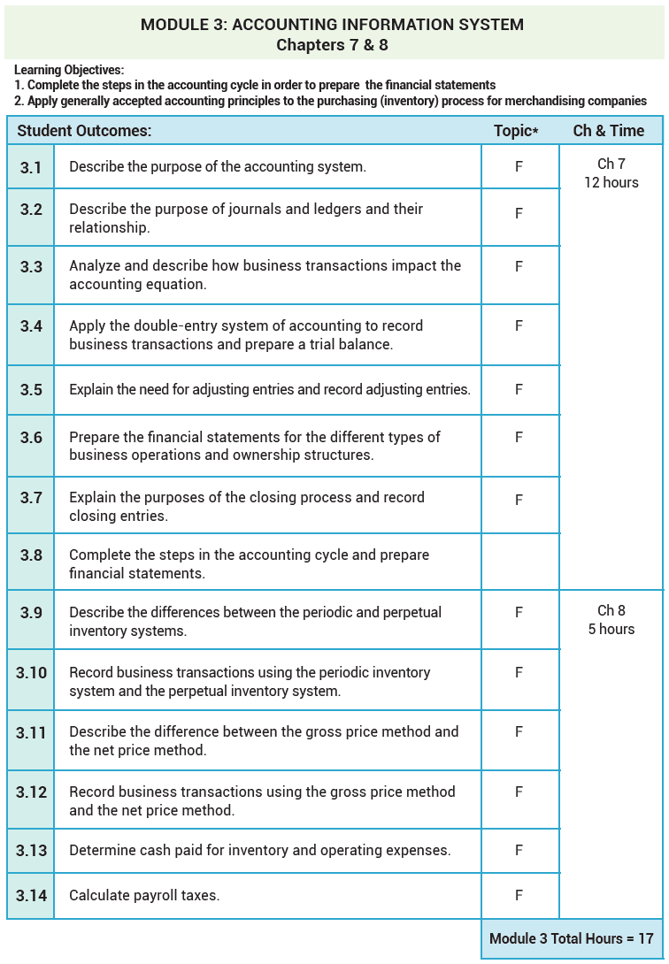

Slide 14
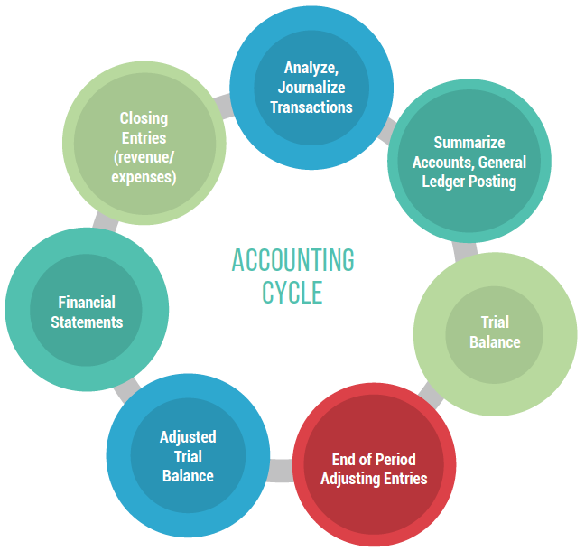

Slide 15
From www.mhhe.com/ainsworth6e - Chapter 7 Additional Problems
P7.1 Kendall Corporation began operations on March 1, 2016 and completed the
following transactions during its first month of operations.
    Issued common stock for $100,000.
    Paid $18,000 for a one-year lease on office space.
    Purchased office equipment costing $35,000 by paying $5,000 cash and signing a five-year note for the balance.
    Purchased office supplies on account, $750.
    Sent a bill for $4,500 to a customer for services performed.
    Received $1,000 from a customer for services to be performed next month.
    Paid employees for hours worked, $1,025.
    Paid half of the amount owed for office supplies in transaction (D), $375.
    Received, but did not pay, the monthly telephone bill, $275.
    Paid a dividend to owners, $2,000.
    Required:
    Determine the effect of each of the preceding events on the accounting equation.
    Prepare the general journal entries to record each of these events. Use T-accounts (see next page) to keep track of balances. Do not prepare the adjusting entries.
    Prepare the income statement for the period.
    Prepare the statement of cash flows for the period.
    Prepare the statement of retained earnings for the period.
    Prepare the balance sheet at the end of the period.
    Prepare the closing entries—use T-accounts.

