Slide 1
CHAPTER 1

Slide 2
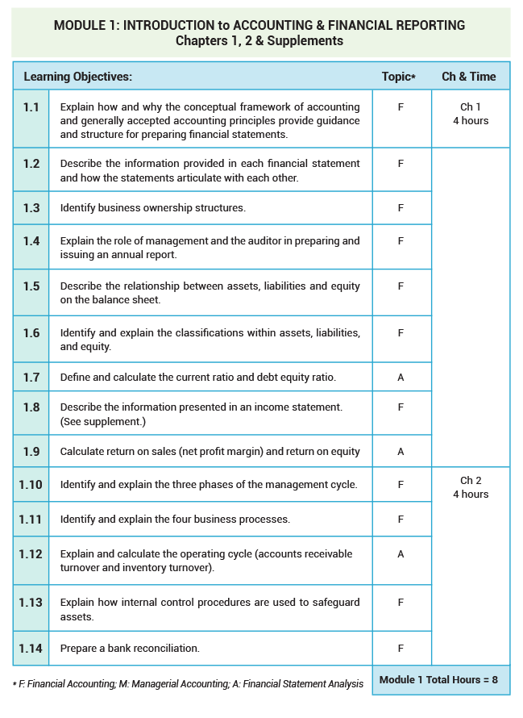

Slide 3
MODULE 1 – Chapters 1 and 2 (8 hours x 60 min.)/50 min. class = 9.6 class periods
Class | Chapter | Lecture Topic(s) | Related Exercises, Problems, & Supplements
1 | 1 pp.2-26 | -Five basic functions of a business -The development of business and accounting -Specialties in Accounting | E1.5, 1.6, 1.8, 1.11, 1.12, 1.13, 1.14, 1.16, 1.18 P1.1, 1.2, 1.3, 1.4, 1.5 www.startheregoplaces.com
2 | 1 | -Differences among types of businesses and organization structures -GAAP | E1.1, 1.2, 1.3, 1.4 P1.11
3 | 1 | -Purpose of financial statements -Relationship of financial statements | Income Statement Supplement* P1.6, 1.7, 1.8, 1.9, 1.10
4 | 1 | -Current ratio, return on sales, and debt-to-equity ratio | E1.7, 1.9, 1.15, 1.17, 1.19 In-Class Cases**
5 | 1 | -Review In-Class Cases Chapter 1 Quiz (optional)
6 | 2 pp.37-54 | -Management cycle -Business processes | E2.2, 2.5, 2.14, 2.15, 2.16 Business Processes Diagram*
7 | 2 | -Balance scorecard approach | P2.7, 2.8, CT2.1 Formula Guide*
8 | 2 | -Internal controls | E2.6, 2.7, 2.8, 2.9
9 | 2 | -Bank reconciliation Chapter 2 Quiz (optional) | P2.1, 2.2, 2.3
10 | 2 | Module Review Problems*** | Note card activity* for statements and ratio review
11 | 1 & 2 | Module Exam 1 (part 1)
12 | 1 & 2 | Module Exam 1 (part 2)
13 | 1 & 2 | Review Module Exam 1

Slide 4
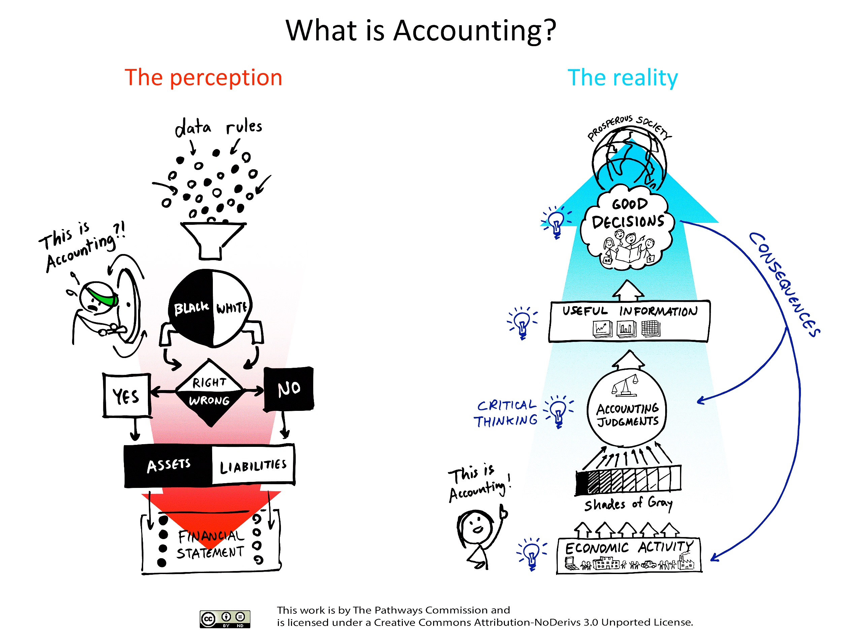
What is Accounting?

Slide 5


www.startheregoplaces.com/students/why-accounting/career-options/

Slide 6
Business Ownership Structures
Sole Proprietorships & Partnerships (single or multiple owners)
  Advantages:
    Ease of formation
    Income taxes only at the individual’s level
    More owner involvement
  Disadvantages:
    Unlimited liability
    Limited ability to raise capital
    Mutual agency (partnerships)
Corporations (Stockholders)
  Advantages:
    Limited liability
    Unlimited life
    Ability to raise capital
  Disadvantages:
    Regulatory requirements
    Double taxation

Slide 7
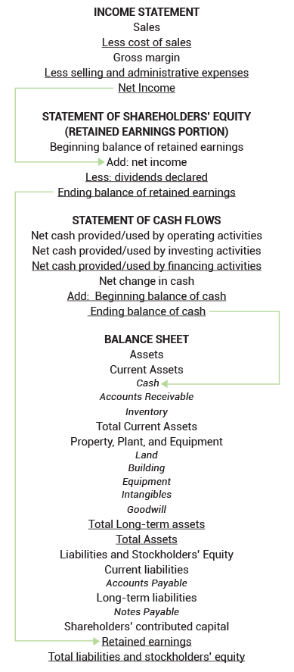

Slide 8
Income Statement Supplement
Read through with students

Slide 9
Note Card Activity
Description:
This activity covers the financial statements and ratios. Handout the account note cards randomly to students. Ask them to make two groups - income statement and balance sheet. You can give them a blank form and ask them to write up an organized statement for each (or, you can have them lineup according to the order of the statement they represent). Next, handout the ratio note cards randomly and ask students to find the people they need to calculate the ratio on their card.
Rationale:
This activity works because it gets students actively involved in reviewing their understanding of the accounts that make up the Income Statement and Balance Sheet. It also tests their ability to calculate ratios from the statements.

Slide 10
Investopedia
Current Ratio
http://www.investopedia.com/video/play/current-ratio/?ad=dirN&qo=investopediaSiteSearch&qsrc=0&o=40186
Return on Sales Ratio
http://www.investopedia.com/video/play/return-sales/?ad=dirN&qo=investopediaSiteSearch&qsrc=0&o=40186
Debt to Equity ratio explained
https://www.youtube.com/watch?v=LWbih-AIfTM

Slide 11
Income Statement
Farwell Company has the following information available from its most recent fiscal year. Use the relevant information to determine the net income (loss) for the period.
Cash sales, $40,000
Employee salary expense, $30,000
Common stock issued for cash, $100,000
Sales on account, $58,000
Utility expense, $1,500
Long-term loan received, $50,000
Interest earned on investments, $100
Property tax expense, $10,000
Inventory purchased for resale, $120,000
Cost of inventory sold, $102,000
Insurance purchased for the next year, $4,800
Rent expense, $12,000
Revenues:
Cash Sales $40,000
Sales on Account $58,000
Total Revenue $98,000
Expenses:
COGS 102,000
Empl salary expense 30,000
Utility expense 1,500
Property tax expense 10,000
Rent expense 12,000
Total Operating Expenses $155,500
Operating Income ($57,500)
Interest Income 100
Net Income (Loss) ($57,400)

Slide 12
Accounting in the Headlines
www.accountingintheheadlines.com

Slide 13
At Lululemon, how can sales be up while gross margin is down?
Accounting in the Headlines
Original blog posting (January 28, 2016)

Slide 14

Lululemon Athletica Inc.
Lululemon is an athletic apparel company
Founded in 1988 and headquartered in Canada
Helped popularize yoga pants in the U.S.
During 2015, Lululemon’s sales increased while its gross margin declined
Photographer: http://www.123rf.com/profile_micchaelpuche

Slide 15
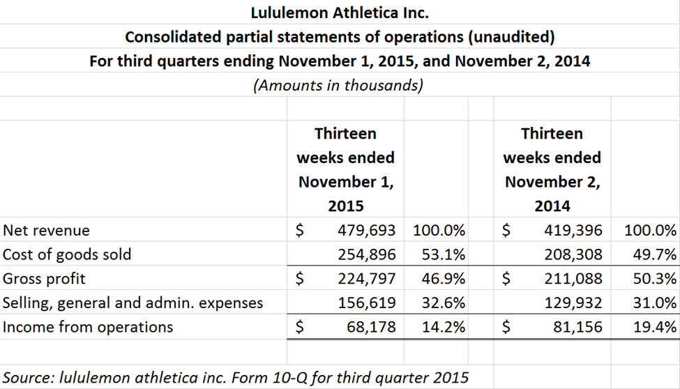

Slide 16
Question 1
How is gross margin
(also known as gross profit)
calculated?

Slide 17
Question 2
If sales increase, what would you ordinarily expect to happen to gross margin?

Slide 18
Question 3
Examine the statements of operations for Lululemon as given in the article. Is the Wall Street Journal headline referring to dollars or percentages?

Slide 19
Question 4
What do you know about expenses at Lululemon during 2015 based on the Wall Street Journal headline?

Slide 20
Question 5
What possible reasons might there be for this situation to have occurred at Lululemon?

Slide 21
Question Recap
How is gross margin (also known as gross profit) calculated?
If sales increase, what would you ordinarily expect to happen to gross margin?
Examine the statements of operations for Lululemon as given in the article. Is the Wall Street Journal headline referring to dollars or percentages?
What do you know about expenses at Lululemon during 2015 based on the Wall Street Journal headline?
What possible reasons might there be for this situation to have occurred at Lululemon?

Slide 22
For additional news stories to use in the accounting classroom, see the Accounting in the Headlines blog at http://accountingintheheadlines.com/
Questions or comments?
Contact Dr. Wendy Tietz at wtietz@kent.edu

Slide 23
CHAPTER 2

Slide 24
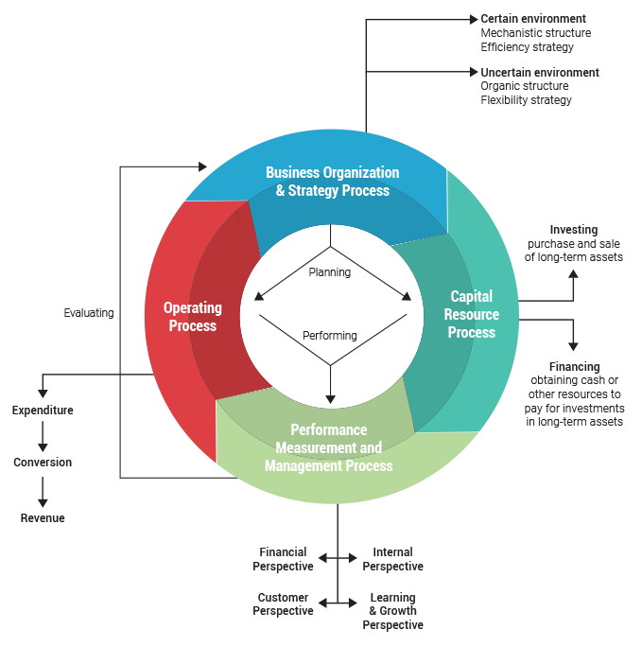

Slide 25
Balance Scorecard
Financial Perspective
Internal Perspective
  https://accountingintheheadlines.com/2016/06/30/what-type-of-quality-costs-would-the-torn-puma-soccer-jerseys-be-considered/
Customer Perspective
Learning and Growth Perspective

Slide 26
Financial Analysis (P2.7 pg.60)
Petrisin Company – Comparative Balance Sheet – December 31, 2014 and 2013
2014 2013
Cash $ 24,200 $ 20,000
Accounts receivable 45,650 39,000
Inventory 79,200 64,000
Plant and equipment 316,800 265,000
Accumulated depreciation (88,000) (72,000)
Total assets $377,850 $316,000
Accounts payable $ 26,400 $ 37,000
Wages payable 3,850 4,000
Taxes payable 7,425 8,500
Bonds payable 110,000 100,000
Common stock 88,000 80,000
Retained earnings 142,175 86,500
Total liabilities and shareholder’s equity $377,850 $316,000
_________________________________________________________________________________
Petrisin Company – Income Statement – For the Year Ended December 31, 2014
Sales $400,000
Cost of goods sold 231,750
Gross margin $ 168,250
Operating expenses:
Selling expense $39,000
Rent expense 45,000
Depreciation expense 11,000
Bad debt expense 1,715
Interest expense 15,000 111,715
Income from operations $ 56,535
Loss on sale of equipment (2,000)
Income before taxes $ 54,535
Income tax expense 11,785
Net income $ 42,750
Quick ratio:
(Cash + Short-term investments + Receivables) / Current liabilities
($24,200+ $45,650) /
($26,400+ $3,850+ 7,425) = 1.85

Slide 27
Financial Analysis
Petrisin Company – Comparative Balance Sheet – December 31, 2014 and 2013
2014 2013
Cash $ 24,200 $ 20,000
Accounts receivable 45,650 39,000
Inventory 79,200 64,000
Plant and equipment 316,800 265,000
Accumulated depreciation (88,000) (72,000)
Total assets $377,850 $316,000
Accounts payable $ 26,400 $ 37,000
Wages payable 3,850 4,000
Taxes payable 7,425 8,500
Bonds payable 110,000 100,000
Common stock 88,000 80,000
Retained earnings 142,175 86,500
Total liabilities and shareholder’s equity $377,850 $316,000
_________________________________________________________________________________
Petrisin Company – Income Statement – For the Year Ended December 31, 2014
Sales $400,000
Cost of goods sold 231,750
Gross margin $ 168,250
Operating expenses:
Selling expense $39,000
Rent expense 45,000
Depreciation expense 11,000
Bad debt expense 1,715
Interest expense 15,000 111,715
Income from operations $ 56,535
Loss on sale of equipment (2,000)
Income before taxes $ 54,535
Income tax expense 11,785
Net income $ 42,750
Current ratio:
Current assets / Current liabilities
($24,200 + $45,650 + $79,200) /
($26,400 + $3,850 + 7,425) = 3.96

Slide 28
Financial Analysis
Petrisin Company – Comparative Balance Sheet – December 31, 2014 and 2013
2014 2013
Cash $ 24,200 $ 20,000
Accounts receivable 45,650 39,000
Inventory 79,200 64,000
Plant and equipment 316,800 265,000
Accumulated depreciation (88,000) (72,000)
Total assets $377,850 $316,000
Accounts payable $ 26,400 $ 37,000
Wages payable 3,850 4,000
Taxes payable 7,425 8,500
Bonds payable 110,000 100,000
Common stock 88,000 80,000
Retained earnings 142,175 86,500
Total liabilities and shareholder’s equity $377,850 $316,000
_________________________________________________________________________________
Petrisin Company – Income Statement – For the Year Ended December 31, 2014
Sales $400,000
Cost of goods sold 231,750
Gross margin $ 168,250
Operating expenses:
Selling expense $39,000
Rent expense 45,000
Depreciation expense 11,000
Bad debt expense 1,715
Interest expense 15,000 111,715
Income from operations $ 56,535
Loss on sale of equipment (2,000)
Income before taxes $ 54,535
Income tax expense 11,785
Net income $ 42,750
Gross margin ratio:
Gross margin / Sales
$168,250 / $400,00 = 42.06

Slide 29
Financial Analysis
Petrisin Company – Comparative Balance Sheet – December 31, 2014 and 2013
2014 2013
Cash $ 24,200 $ 20,000
Accounts receivable 45,650 39,000
Inventory 79,200 64,000
Plant and equipment 316,800 265,000
Accumulated depreciation (88,000) (72,000)
Total assets $377,850 $316,000
Accounts payable $ 26,400 $ 37,000
Wages payable 3,850 4,000
Taxes payable 7,425 8,500
Bonds payable 110,000 100,000
Common stock 88,000 80,000
Retained earnings 142,175 86,500
Total liabilities and shareholder’s equity $377,850 $316,000
_________________________________________________________________________________
Petrisin Company – Income Statement – For the Year Ended December 31, 2014
Sales $400,000
Cost of goods sold 231,750
Gross margin $ 168,250
Operating expenses:
Selling expense $39,000
Rent expense 45,000
Depreciation expense 11,000
Bad debt expense 1,715
Interest expense 15,000 111,715
Income from operations $ 56,535
Loss on sale of equipment (2,000)
Income before taxes $ 54,535
Income tax expense 11,785
Net income $ 42,750
Return on sales ratio:
Net income / Sales
$42,750 / $400,00 = 10.69

Slide 30
Financial Analysis
Petrisin Company – Comparative Balance Sheet – December 31, 2014 and 2013
2014 2013
Cash $ 24,200 $ 20,000
Accounts receivable 45,650 39,000
Inventory 79,200 64,000
Plant and equipment 316,800 265,000
Accumulated depreciation (88,000) (72,000)
Total assets $377,850 $316,000
Accounts payable $ 26,400 $ 37,000
Wages payable 3,850 4,000
Taxes payable 7,425 8,500
Bonds payable 110,000 100,000
Common stock 88,000 80,000
Retained earnings 142,175 86,500
Total liabilities and shareholder’s equity $377,850 $316,000
_________________________________________________________________________________
Petrisin Company – Income Statement – For the Year Ended December 31, 2014
Sales $400,000
Cost of goods sold 231,750
Gross margin $ 168,250
Operating expenses:
Selling expense $39,000
Rent expense 45,000
Depreciation expense 11,000
Bad debt expense 1,715
Interest expense 15,000 111,715
Income from operations $ 56,535
Loss on sale of equipment (2,000)
Income before taxes $ 54,535
Income tax expense 11,785
Net income $ 42,750
A/R turnover:
Sales / Average accounts receivable
$400,000 / ([$39,000 + $45,650] / 2) = 9.45 times
Days in the collection period: 356 / 9.45 = 38.62 days

Slide 31
Financial Analysis
Petrisin Company – Comparative Balance Sheet – December 31, 2014 and 2013
2014 2013
Cash $ 24,200 $ 20,000
Accounts receivable 45,650 39,000
Inventory 79,200 64,000
Plant and equipment 316,800 265,000
Accumulated depreciation (88,000) (72,000)
Total assets $377,850 $316,000
Accounts payable $ 26,400 $ 37,000
Wages payable 3,850 4,000
Taxes payable 7,425 8,500
Bonds payable 110,000 100,000
Common stock 88,000 80,000
Retained earnings 142,175 86,500
Total liabilities and shareholder’s equity $377,850 $316,000
_________________________________________________________________________________
Petrisin Company – Income Statement – For the Year Ended December 31, 2014
Sales $400,000
Cost of goods sold 231,750
Gross margin $ 168,250
Operating expenses:
Selling expense $39,000
Rent expense 45,000
Depreciation expense 11,000
Bad debt expense 1,715
Interest expense 15,000 111,715
Income from operations $ 56,535
Loss on sale of equipment (2,000)
Income before taxes $ 54,535
Income tax expense 11,785
Net income $ 42,750
Inventory turnover:
Cost of sales / Average inventory
$231,750 / ([$79,200 + $64,000] / 2) = 3.24
Days in the selling period: 356 / 3.24 = 112.65 days

Slide 32
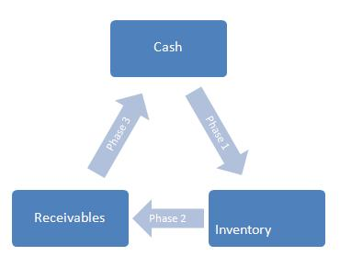
Length of Operating Cycle
Days in selling period + Days in collection period
Or, in other words:
Length of time between when a company purchases items for inventory and when it receives payment for sale of the items.
A long operating cycle tends to harm profitability by increasing borrowing requirements and interest expense.

Slide 33
Note Card Activity
Try this activity again,
now completing ratios

Slide 34
Internal Controls
Control Environment
Risk Assessment
Control Activities
Information & Communication
Monitoring Activities

Slide 35
What internal controls might have prevented a SeaWorld guest relations supervisor from voiding tickets and pocketing more than $116,000?
Accounting in the Headlines
Original blog posting (June 21, 2016)

Slide 36

SeaWorld Internal Controls
Guest relations supervisor, Lisa Olivardia, would void tickets and pocket the cash
Estimated she stole $55,000 to $75,000 a year from 2013 – 2015
Voided transactions were triple the rate of her co-workers
Allegedly stole cash from co-workers’ cash drawers as well
Employee for almost 30 years prior to being caught

Slide 37
Question 1
What internal controls might have prevented this theft?

Slide 38
Question 2
Why might Sea World have not had these controls in place?

Slide 39
Question Recap
What internal controls might have prevented this theft?
Why might Sea World have not had these controls in place?

Slide 40
For additional news stories to use in the accounting classroom, see the Accounting in the Headlines blog at http://accountingintheheadlines.com/
Questions or comments?
Contact Dr. Wendy Tietz at wtietz@kent.edu

Slide 41
The Profit
Season 1, episode 3
Planet Popcorn

Slide 42
Bank Reconciliation
You know this one

Slide 43
Module 1 Exam
What does it look like?

